Slide 1
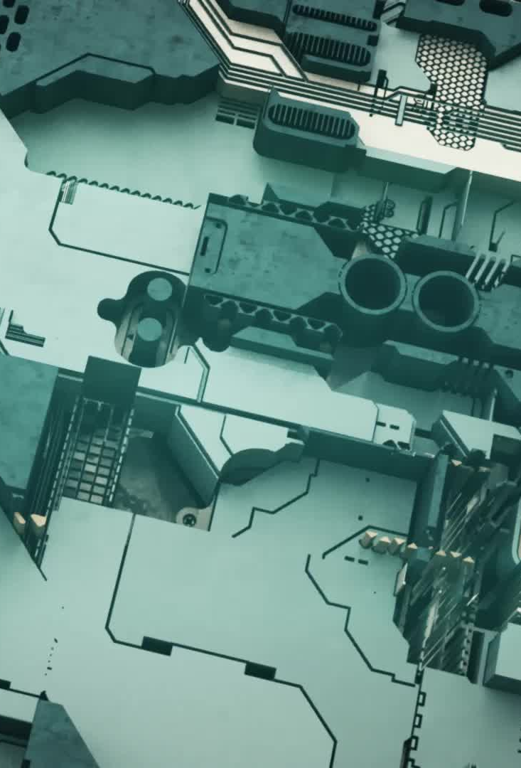
Model Development for Autonomous Image Captioning Using Transformer Architecture
By

Slide 2
Project Background and Topic Summary
Image captioning specifies a dedicated research area gaining significant level of importance as it aims at generating descriptions in natural language for the visual content present in stationary images (Deorukhkar and Ket, 2022).
This research focuses on the research problem of autonomous image captioning, which consists of numerous capabilities, involving significant work across wide range of application domains like captioning medical images, analysis of traffic data and facilitating interaction between human and computer (Ghandi et al, 2023).
For human beings, describing visual content of images and providing captions to it is a quick daily activity which doesn’t need any kind of complex activities.
A machine that autonomously generate image captions is required to carryout a number of complex activities like categorizing image objects, abstracting attributes of the image, classification of relation between objects and its attributes and scene deducing in accurate manner for generation of caption briefing (Deorukhkar and Ket, 2021).
In other words, the complexity involved in autonomous image captioning is because of the machines expected to carryout many activities like object recognition from visual content of the image, extracting the information about the object, knowing about image context besides presenting the captions of the image using natural language.
Despite the existence of such complex activities, it is still important to carryout them because of its usage across wide application areas like medical image captioning, X-ray description, assisting visually impaired and content related image retrieval in biomedicine (Hossain et al, 2019).

Slide 3
Project Rationale
The problem of the autonomous image captioning was addressed in the existing literature using deep learning techniques (Ghandi et al, 2023; Stefanini et al, 2023).
Some of these existing deep learning techniques applied for image captioning are attention method, graph based techniques, reinforcement learning techniques and the convolutional networks (Ghandi et al, 2023).
Also, evaluation of these existing techniques showed the presence of the limitations within the image captioning process. Some of these limitations are related to concrete object description, absence of considering the context of visual content and dependency of each word generated on the previous words generated in the sentence (Stefanini et al, 2022).
This shows the existence of significant area of improvements and potential future research directions in this area of image captioning, which include development of high quality captions for the images, enhancing the caption generation through incorporation of vision-language methods.
The rationale of undertaking this research is to apply transformer architecture to develop an autonomous image captioning model.
MS COCO and Flickr 8k datasets are considered in this research to train and test the autonomous image captioning model as part of this research work.

Slide 4
Aim, Objectives and Research Question of Project
This research is aimed at developing autonomous image captioning model using transformer architecture.
Research Objectives
To analyse the importance of developing a model that can perform image captioning activity in autonomous manner.
To develop autonomous image captioning model using transformer architecture and machine learning algorithms.
To train the developed model to perform the autonomous image captioning using MS COCO and Flickr 8k datasets.
To test the developed model using MS COCO and Flickr 8k dataset for autonomous image captioning.
Comparing transformer model with Recurrent Neural Networks (RNNs)
Research Question
How does a transformer architecture support the model development for autonomous image captioning?

Slide 5
Models Used
Transformer architecture is an architectural model of deep learning, which used self-attention method for input data processing and handling a large sequence of the data in parallelized manner (Min et al, 2022).
Recurrent Neural Networks (RNN) come under a kind of the artificial neural network involved for processing the sequential data (Salem, 2022).
Long Short Term Memory (LSTM) is a type of the recurrent neural network, which was developed to address the gradient problem faced by the recurrent neural networks.
LSTM working is based on applying memory cell along with system of the fates used for controlling information flow (Min et al, 2022).

Slide 6
Task List
List of Tasks | Short Description | Due Dates
Project Topic Selection and Justification | Different topics were researched, and the most suitable one was chosen with proper justification | 2024-10-07
Project and Data Management Plan Preparation | Prepare PDM plan as per the requirements | 2024-10-11
Presenting Project and Data Management Plan | Prepare and provide the presentations | 2024-10-14
Review of the Literature | Complete the review of available literature | 2024-10-31
Preprocessing of Datasets | Download the datasets and preprocess them | 2024-11-21
Model Development from Transformer Architecture | Complete the model development activity | 2024-11-28
Model Training Using MS COCO and Flicker8k | Train the developed model | 2024-12-12
Model Testing using MS COCO and Flickr 8k | Test the developed model | 2024-12-24
Evaluation of Developed Model | Model evaluation using qualitative and quantitative metrics | 2024-12-31
Documentation of the Project | Document all the project findings | 2025-01-06

Slide 7
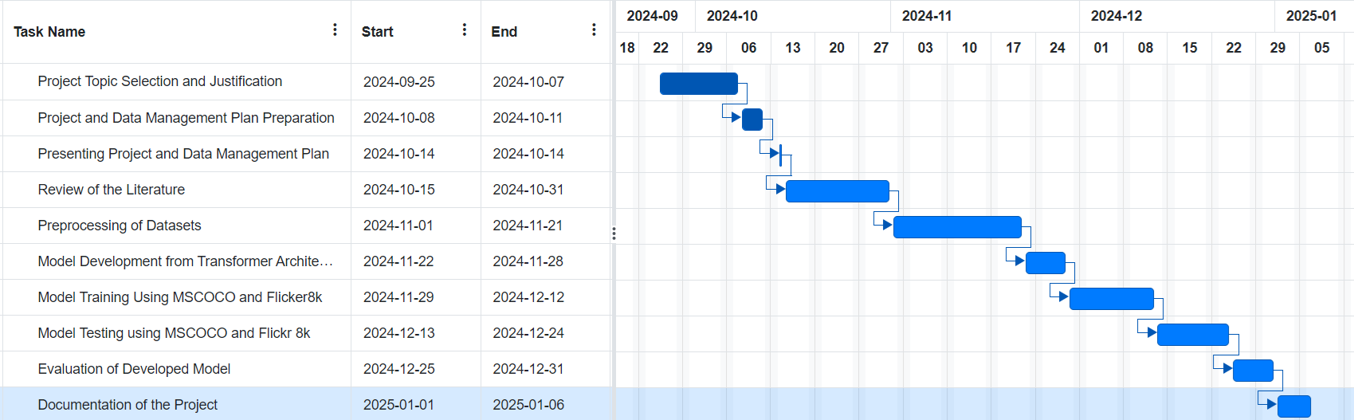
Timeline

Slide 8
Data Management Plan
Overview of Dataset
MS COCO dataset was collected by Microsoft Corporation by selecting images about the everyday scenes and the objects. Flickr 8k dataset was collected by selecting images from the Flickr image sharing platform. Both MS COCO and Flick 8K datasets contain images about the everyday events of the people. Yes, the image dataset is greatly anonymised.
Data Collection
Data set1: MS COCO
https://cocodataset.org/#home
Data set 2: Flickr 8K
https://www.kaggle.com/datasets/adityajn105/flickr8k
Meta Data
MS COCO and Flick 8k datasets are both images. MS COCO consists of nearly 330,000 images where 200,000 images are labelled. Flick 8k consists of 8000 images.

Slide 9
Data Management Plan (Cont…)
Readme File: This file will contain list of steps that are to be followed to run the developed model and generate autonomous image caption.
GitHub Link: https://github.com/DATASCIENCEFINALPROJECT-MANASA/Autonomous-Image-Captioning
Security and Storage: Project files will be backed up once in a week into Google Drive of my email that is password protected. Project files and documents will be shared to the supervisor through GitHub and OneDrive depending on the requirements.
Ethical Requirements: The chosen datasets: MS COCO and Flicker8k doesn’t come under GDPR requirements as it doesn’t consist of any personal information of the people. Also, this project meets UH ethical policies due to the use of secondary data for model development. There exists ethical permission and license to use MS COCO and Flicker datasets for this project work.

Slide 10
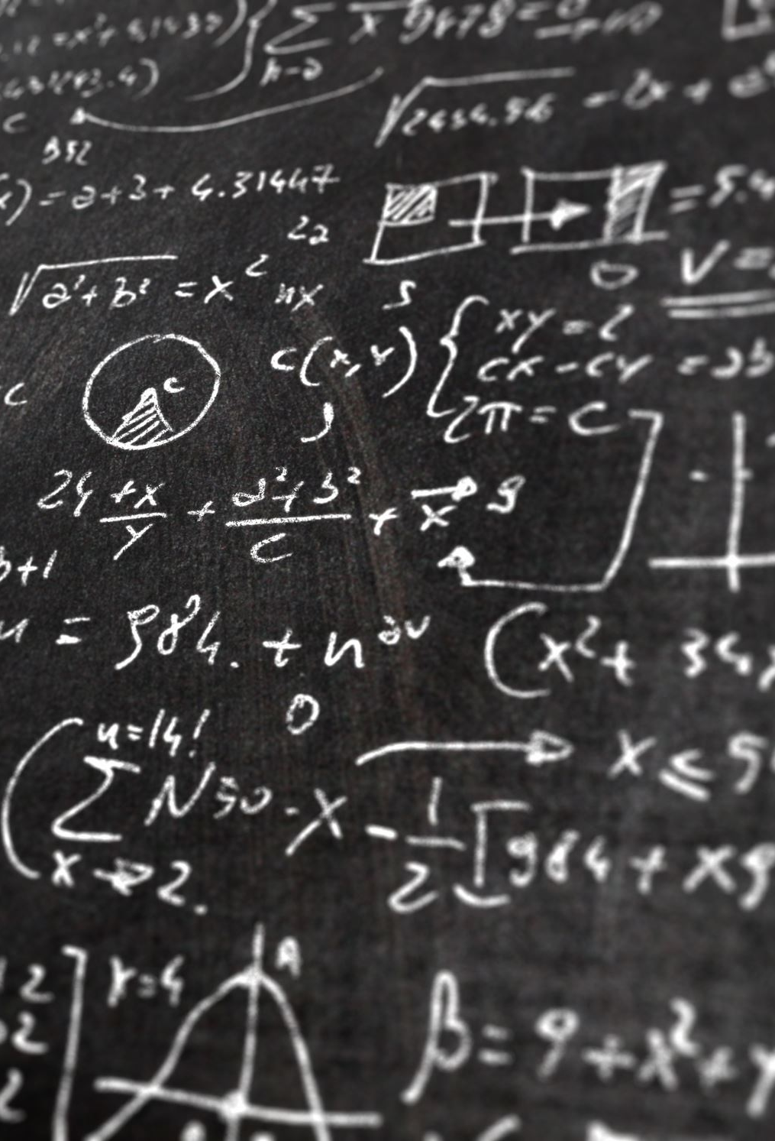
References
Deorukhkar, K., & Ket, S. (2022). A detailed review of prevailing image captioning methods using deep learning techniques. Multimedia Tools and Applications, 81(1), 1313-1336.
Geetha, G., Kirthigadevi, T., Ponsam, G. G., Karthik, T., & Safa, M. (2020, December). Image captioning using deep convolutional neural networks (CNNs). IOP publishing.
Ghandi, T., Pourreza, H., & Mahyar, H. (2023). Deep learning approaches on image captioning: A review. ACM Computing Surveys, 56(3), 1-39.
Hossain, M. Z., Sohel, F., Shiratuddin, M. F., & Laga, H. (2019). A comprehensive survey of deep learning for image captioning. ACM Computing Surveys (CsUR), 51(6), 1-36.
Stefanini, M., Cornia, M., Baraldi, L., Cascianelli, S., Fiameni, G., & Cucchiara, R. (2022). From show to tell: A survey on deep learning-based image captioning. IEEE transactions on pattern analysis and machine intelligence, 45(1), 539-559.

Slide 11

Thank You

